Slide 1
Scrum Burndown Charts
Mike Blatter

Slide 2
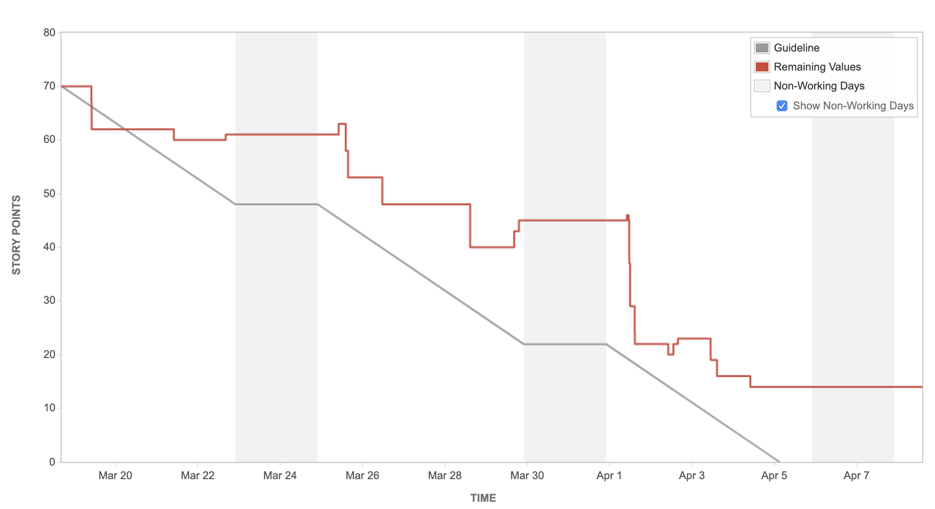
rundown on the burndown
Represents remaining effort given time
Grouped by sprint or release
X axis represents time
Most graphs involving time are represented by the X axis
By any other measure very independent from other measures (can’t control)
Y axis represents remainder of work

Slide 3
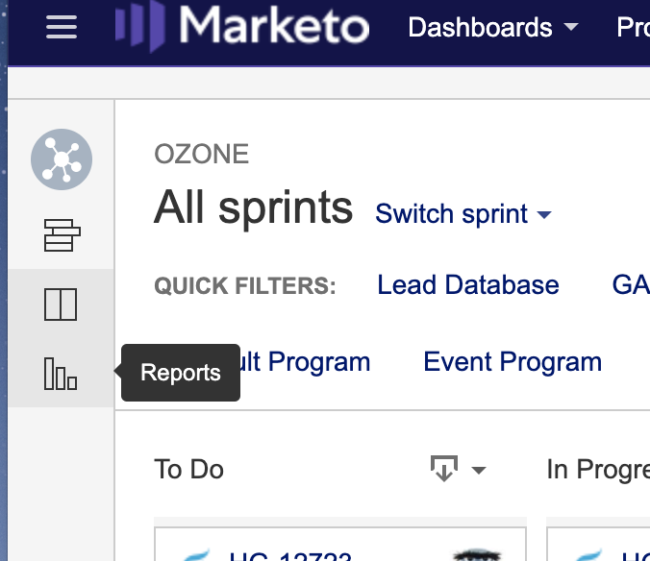
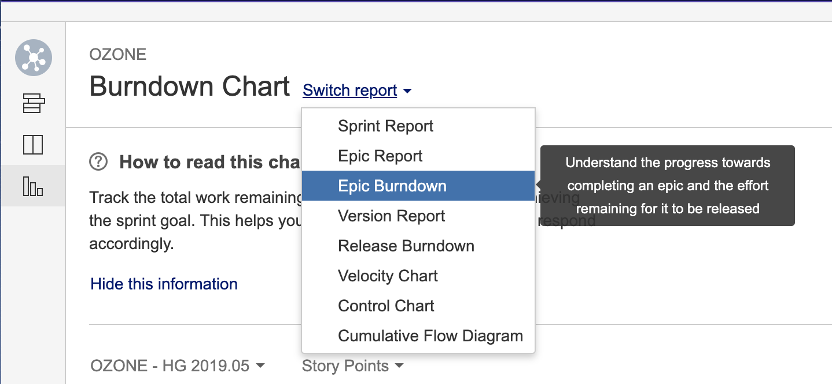
get down ON the burndown
Go to your JIRA project board
Click on the “Reports” icon
Burndown chart should be default
If not, you can select which chart you would like above the graph

Slide 4
notes on analyzing burndowns
When inspecting quality/production you cannot look at graphs alone to determine meaning
Analyzing graphs and data is required
This will help eliminate random events or if the cause even needs to be corrected
Example: JIRA permissions were broken for developers so no updates in reporting occurred for a few days
Very common process among many different disciplines like Six Sigma DMAIC or Scientific Method
DMAIC: Define, Measure, Analyze, Improve, and Control
Sci Method: Ask Question, Research, Hypothesis, Test/Gather Data, Analyze, and Report
Notes:
Six Sigma

Slide 5
avoiding stairs
Stairs can occur when stories are large
Increases misinterpretations (progress less effectively communicated)
Breaking down stories (if possible) into smaller points can reduce this affect
Also breaking down stories can help improve reporting by showing a more accurate version of what’s complete and incomplete

Slide 6
ideal team
This great team was able to organize itself well
Great product owner
Understand need for locked sprint backlog
Great scrum master helping the team
Estimated capacity correctly
Finished on time
No corrective action necessary

Slide 7
great team
May be observed on experienced teams
Completed sprint on-time and met goals
Adapted scope of sprint over time
Should discuss why progress was slow at initial start and solve related issues
Should consider how they are estimating capacity for better sprint planning

Slide 8
Nice team
Typical progress observed on many agile teams
Team was able to meet commitment
Team adapted the scope of work or worked harder to meet commitments (Self reflecting)
Team should of discuss change of plan as soon as progress has slowed
Typically lower priority item is suggested to be removed from sprint

Slide 9
Boom! its too late
Chart says you didn’t meet your commitment
Team was late for the entire sprint
Didn’t adapt scope to appropriate level
Next sprint should lower capacity estimate
When team finds slow down of a couple days, find and apply possible corrective actions for issues in productivity
Typically lower priority story should be moved to backlog

Slide 10
Boom! Too Early
Team finished work sooner than expected
Didn’t work on additional stories even though had capacity
Stories were probably overestimated
Velocity of team is not being calculated correctly
Scrum master must ensure team is fixing estimations and stories are ready to pull in and work on

Slide 11
Let’s have a rest
Team either has committed to less than it could complete or there are not enough stories provided
Reason might be overestimating complexity and finishing early
Scrum master should identify problem and ask product owner to supply more work
Even if stories are over-estimated should continue with pre-planned sprint

Slide 12
oh, management is coming!
Team is probably doing some work but not updating progress
Another is product owner has added same amount of work that was completed
Team cannot predict end or status of the sprint
Scrum master should remind everyone it’s necessary to report progress
After 2/3 days of this activity team should be stopped and corrective actions applied

Slide 13
do your duties
Team is non-functional
Scrum master cannot coach team on why it’s necessary to report progress
Product owner doesn’t care either
To fix, team should restart from scratch and have retrospective on why this is occurring

Slide 14
zero effort
Stories/tasks not pointed and the sprint hasn’t officially started
To fix, team should have planning meeting, estimate stories, include them into new sprint
Then start new sprint

Slide 15
up to the sky
First sprints typically look like this
Good knowledge resource and high visibility failure
Stories were added to backlog and/or stories were re-estimated a lot
Sprint backlog should be re-evaluated and rearranged immediately
Coaching for the team may also be helpful in this situation

Slide 16
bump on the road
Team has not started sprint correctly
Added stories after sprint has started
Kudos for recognizing it is important to plan and report but started to late
It is suggested that the sprint should be restarted within the shorter timeframe

Slide 17
velocity is not a kpi
Asking to accomplish more story points will lead to story point inflation
Velocity is just a capacity management tool
Points evolve over time with the team’s understanding of complexity

Slide 18
the long run
Burndown charts only describe iterations
Nice burndown charts don’t always correlate indicate a great team and vice versa
Like everything else in agile, we should be iterating towards better productivity and reporting
This is a constant repeating process in self-evaluating the team and improvement

Slide 19
Sources
Great resource explaining burndown charts and meanings:
http://www.methodsandtools.com/archive/scrumburndown.php
Using all the examples in the above link as well as some definitions
JIRA Specific:
https://www.atlassian.com/agile/tutorials/burndown-charts
Six Sigma DMAIC concepts
https://www.thebalancesmb.com/six-sigma-concepts-the-dmaic-problem-solving-method-2221186

